Slide 1
Git Fundamentals

Slide 2
Contents
What is Version Control?
Introduction to Git
Git Terminology
Git Workflow
Basic Git Commands
Collaborating with Git
Git Branching Strategies
Git Best Practices
Conclusion

Slide 3
What is Version Control?
Version control is a system that allows you to track and manage changes to your files over time. It enables collaboration, facilitates easy rollback to previous versions, and provides a centralized source of truth for your project.

Slide 4
Introduction to Git
Git is a distributed version control system widely used in software development. It is known for its speed, scalability, and flexibility. Git allows developers to work on the same codebase simultaneously and manage different versions of files efficiently.

Slide 5
Git Terminology
Repository: A repository is a central storage location where all the project files and their version history are stored.
Commit: A commit is a snapshot of the project at a specific point in time. It represents a set of changes made to the files.
Branch: A branch is a separate line of development. It allows multiple developers to work on different features or bug fixes simultaneously.
Merge: Merging combines changes from one branch into another.
Pull Request: A pull request is a mechanism for submitting changes to a branch and requesting them to be reviewed and merged.

Slide 6
Repositories
Local Repository: A local repository is a copy of the entire project that resides on your local machine. It contains all the project files, commits, branches, and history. You can work on your code, make changes, create branches, and commit locally without affecting others. Local repositories provide flexibility and enable you to work offline.
Remote Repository: A remote repository is a copy of the project stored on a remote server, often hosted on platforms like GitHub, GitLab, or Bitbucket. It serves as a centralized hub for collaboration. Multiple developers can clone the remote repository, make changes, and push their commits to share them with others. Remote repositories facilitate synchronization, code review, and collaboration among team members.

Slide 7
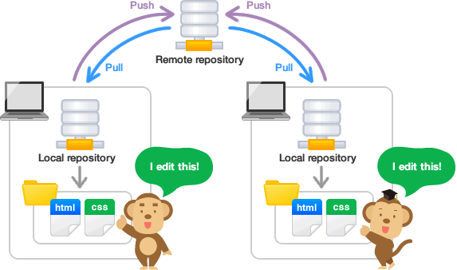

Slide 8
Git Workflow Here is a typical Git workflow:
Initialize a repository: Start by creating a new Git repository or cloning an existing one.
Make changes to files: Modify or add new files in your project.
Stage and commit changes: Select the changes you want to include in a commit and create a commit with a descriptive message.
Create and manage branches: Use branches to isolate different features or bug fixes.
Merge branches: Combine changes from one branch into another.
Resolve conflicts: If multiple branches modify the same file, conflicts may occur. Resolve conflicts manually.
Repeat steps 2-6 as needed.
Push changes: Share your commits with others by pushing them to a remote repository.

Slide 9
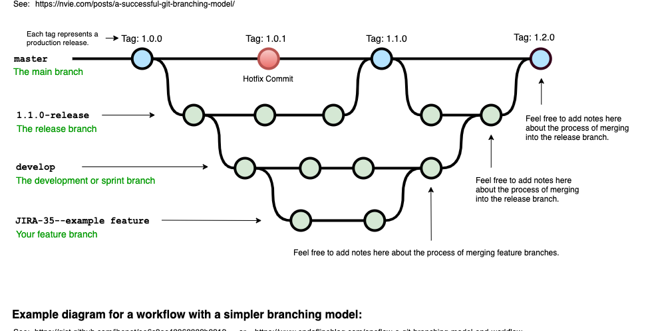

Slide 10
Basic Git Commands
git init: Initialize a new Git repository.
git add: Stage changes to be included in the next commit.
git commit: Create a new commit with the staged changes and a commit message.
git branch: Create, list, or delete branches.
git checkout: Switch to a different branch or restore files from a commit.
git merge: Combine changes from one branch into another.
git pull: Fetch changes from a remote repository and merge them into the current branch.
git push: Push commits to a remote repository.

Slide 11
Collaborating with Git
Git enables efficient collaboration among developers. You can use remote repositories hosted on platforms like GitHub, GitLab, or Bitbucket to share and synchronize your code with others. This allows teams to work on the same project, merge their changes, and resolve conflicts effectively.

Slide 12
Git Branching Strategies
Different branching strategies provide structure to the development process. Some common strategies include:
Feature branching: Each new feature or task is developed in a separate branch and then merged into the main branch.
Release branching: Branching off from the main branch to prepare and test a new release.
Gitflow workflow: A branching model that defines long-term branches for development, releases, and hotfixes.

Slide 13
Git Best Practices
Commit frequently and write meaningful commit messages.
Pull changes regularly to keep your local repository up to date.
Use branches for new features or bug fixes.
Review code changes before merging branches.

Slide 14
Conclusion
In conclusion, Git is a powerful version control system that enables efficient collaboration, easy tracking of changes, and seamless code management. By understanding the basics of Git, you can enhance your software development workflow and work more effectively with your team.

